Slide 1
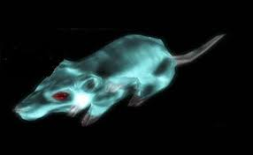
Wendy D,
Mamadou D
& Bryan B,
GhOst RAT

Slide 2
WHAT IS THE RAT ?
REMOTE
ACCESS
TOOL OR TROJAN

Slide 3


Gh0st RAT is a trojan that attacks the Windows operating system. It was created by the C.Rufus Security Team for the purpose of attacking state institutions and making money.

Slide 4
VULNERABILITY; EXPLOIT; ACTOR
VULNERABILITY:
Windows Platforms (failed or nonexistent Patches)
Unaware/Under-Informed Users (usually by spear phishing)
2) EXPLOIT:
Take full control of the remote screen on the infected device
Provide real time and offline keystroke logging
Provide live feed of webcam and/or microphone of infected device
Download remote binaries on the infected remote host
Take control of remote shutdown and reboot of host device
Disable infected computer remote pointer and keyboard
Enter the shell of remote infected host with full control
Provide a list of all the active processes
Clear all existing SSDT of all existing hooks
3) ACTORS: China (2009); USA (NSA, 2013); Could be ANYONE!

Slide 5
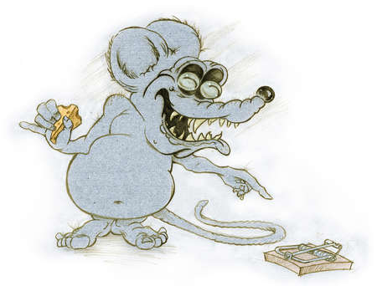
WHAT DAMAGE HAS BEEN DONE?
It is believed that originally GhOst RAT was deployed by the Chinese government to target Tibetan institutions. This trojan ended up infecting 1295 computers in 103 different countries with 1 in 3 of infected hosts representing governmental organizations, military and large companies.

Slide 6



DAMAGE CONTROL
MITIGATE THE DAMAGE:
SECURITY AWARENESS
ANTIVIRUS/SECURITY SOFTWARE
MONITOR TRAFFIC W/ DEEP PACKET MONITORING SECURITY SOLUTIONS
REGULAR INTERNAL PORT SCAN
EVENT LOGS

Slide 7
SOURCES/EDIFICATION/ENJOY!
https://www.rsa.com/content/dam/en/case-study/gh0st-rat.pdf
https://resources.infosecinstitute.com/gh0st-rat-complete-malware-analysis-part-1/#gref
https://cyware.com/news/ghost-rat-an-outline-on-the-remote-access-trojans-high-profile-targets-a44b94d5/
https://blog.trendmicro.com/trendlabs-security-intelligence/tag/gh0st-rat/
https://resources.infosecinstitute.com/gh0st-rat-part-2-packet-structure-defense-measures/#article

